Slide 1
SECURE DATA HIDING IN IMAGES USING STEGANOGRAPHY
CAPSTONE PROJECT
Presented By:
- SAMRADDHI SINGH
- BTECH ( IT )
SHRI RAMSWAROOP MEOMORIAL COLLEGE OF ENGINEERING AND MANAGEMENT

Slide 2
OUTLINE
Problem Statement
Technology used
Wow factor
End users
Result
Conclusion
Git-hub Link
Future scope

Slide 3
Problem Statement
In this project we are going to implement steganography through coding by hiding or encrypting a secret message in the image and with the help of unique key and then decrypting that secret message back from the encrypted image with the help of the already specified unique key.

Slide 4
Technology used
PLATFORM USED :
RAM : 8 GB
OPERATING SYSTEM (OS) : WINDOWS 11
PROCESSOR : Intel ® i3
SYSTEM TYPE : 64-bit operating system
TECHNOLOGIES USED : Steganography
PROGRAMMING LANGUAGE : PYTHON
IDE : IDLE (Python 3.11)
OTHER APPLICATIONS : OpenStego
LIBRARIES USED :
cv2
os
string

Slide 5
Wow factors
In this project , we are using steganography to implement data hiding between the images with the help of python . We have used libraries like cv2 , os , string in this project . We have used IDLE 3.11 (python ide) for the code implementation . With the help of the python code we are taking a message from the user as the input and then encrypt that message in the image by changing the ASCII value in the image and also taking a unique key or password ( for secure encryption and decryption of the message ) in the input . Then code generates an encrypted image which we can later decrypt to find the secret message . But as we associate a key with an image during encryption then we also need that key during encryption .

Slide 6
End users
Large companies and government organizations all need cybersecurity professionals to protect their systems, networks, and data. The financial, government, education, and retail sectors are some of the most prominent players because of their size. But nearly all organizations need some form of cybersecurity, and the need crosses all industries. Some of these industries are mentioned below :
Computer technology Media and Entertainment
Finance and banking Telecommunications
Healthcare and pharmaceuticals Hospitality and Tourism
Education Insurance
Retail and e-commerce Real Estate
Gaming Non Profit and Social Sector
Transportation and logistics Agriculture
Energy and utilities Construction
Government and public sector Automotive
Manufacturing Aerospace and Defense

Slide 7
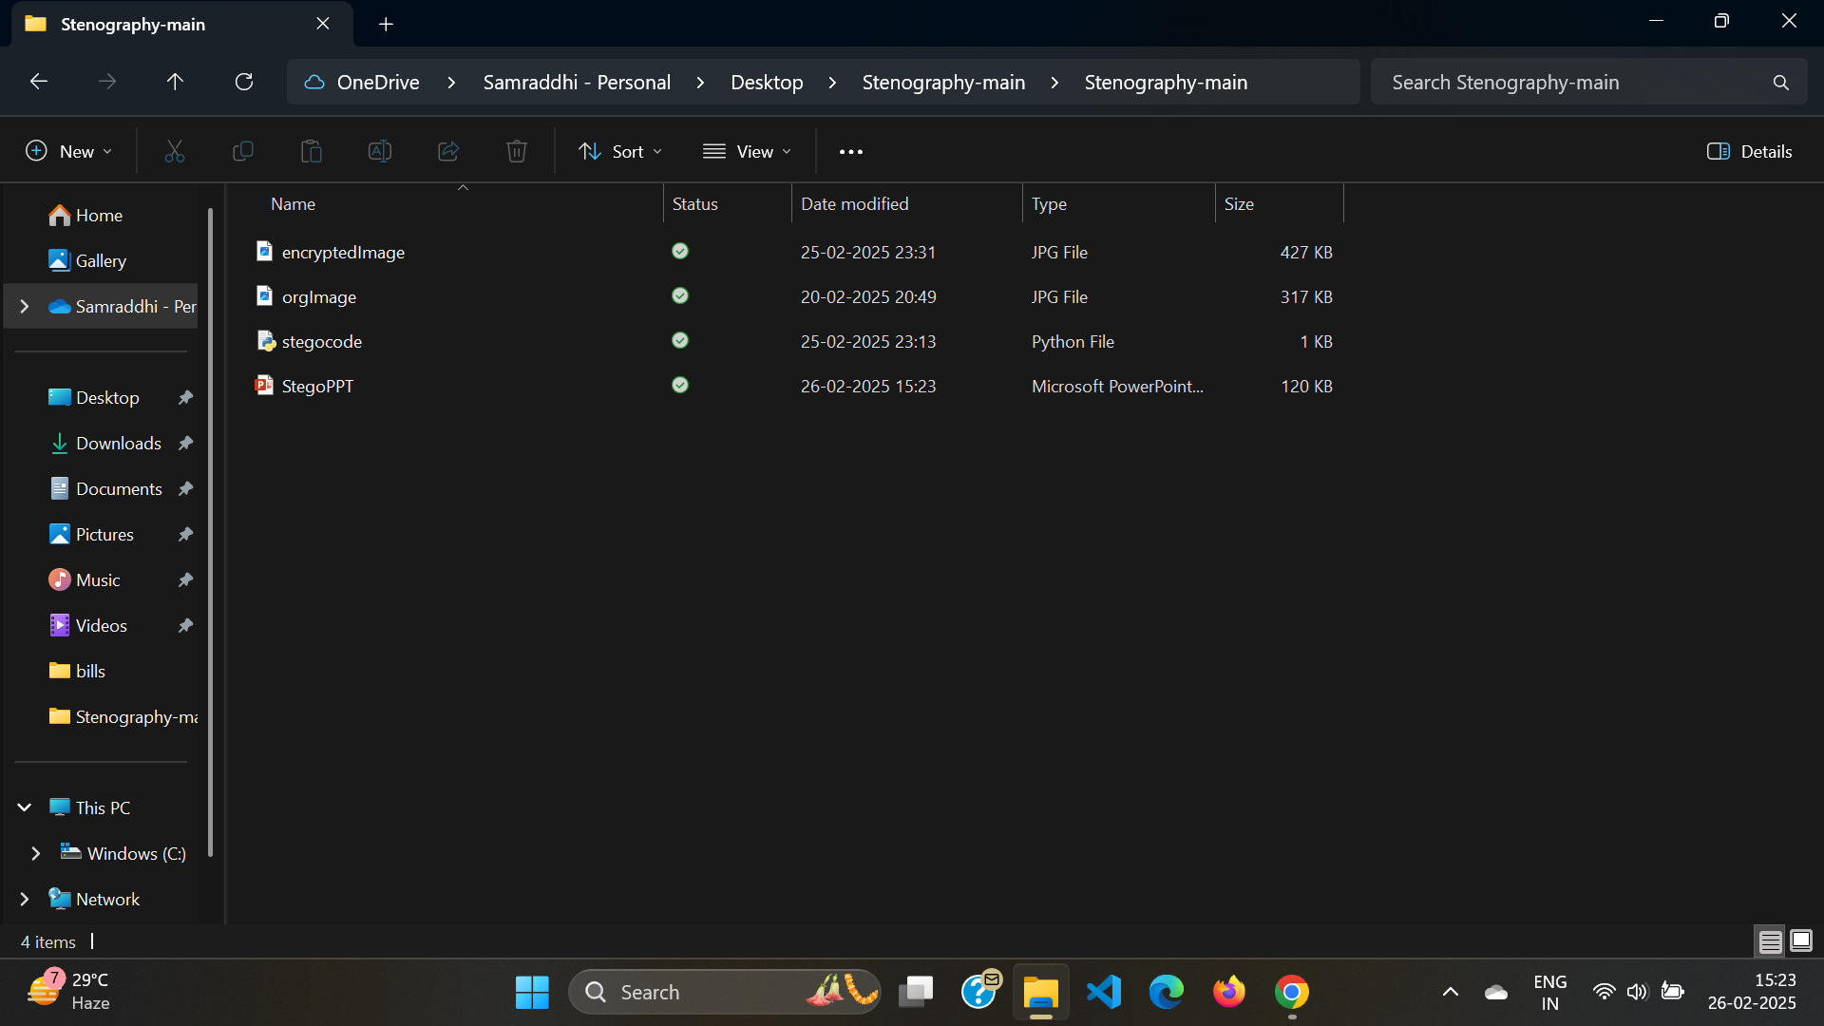
Results

Slide 8
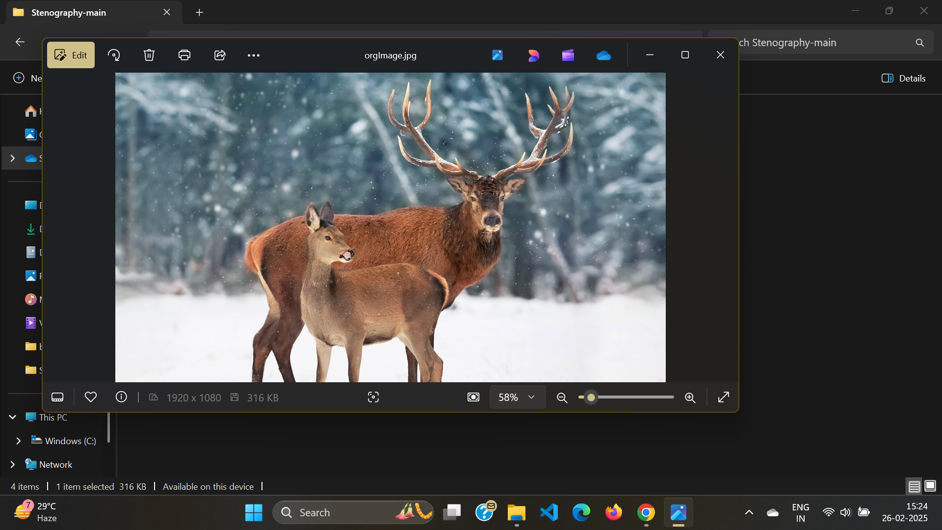
Original image

Slide 9

Encrypted Image

Slide 10
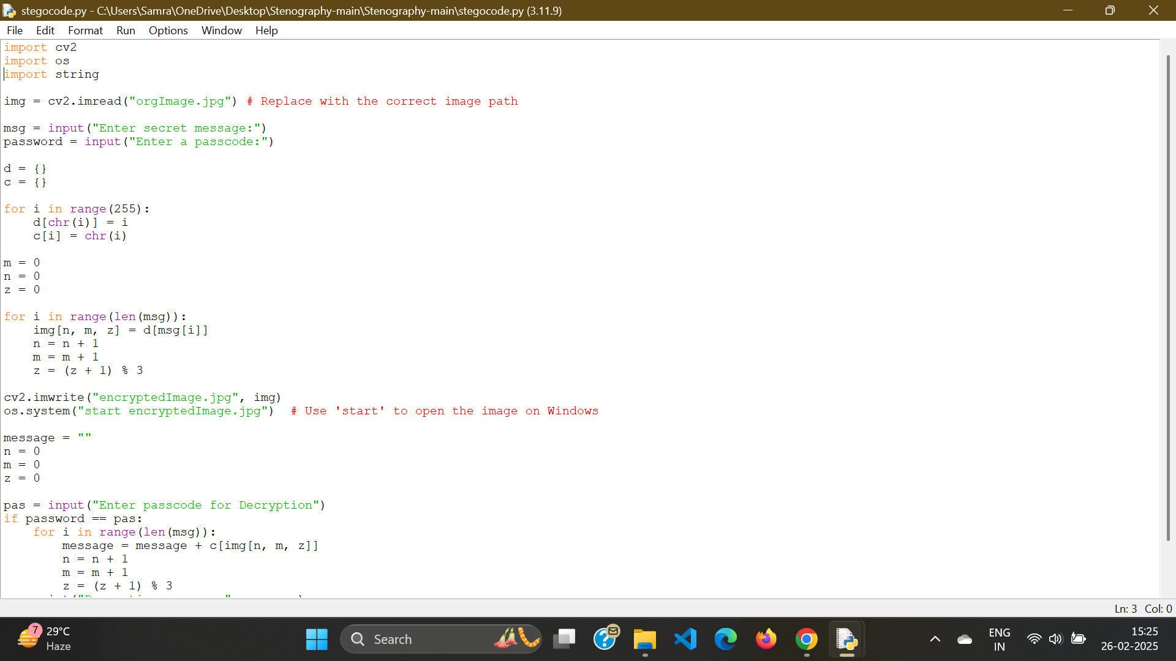
code

Slide 11
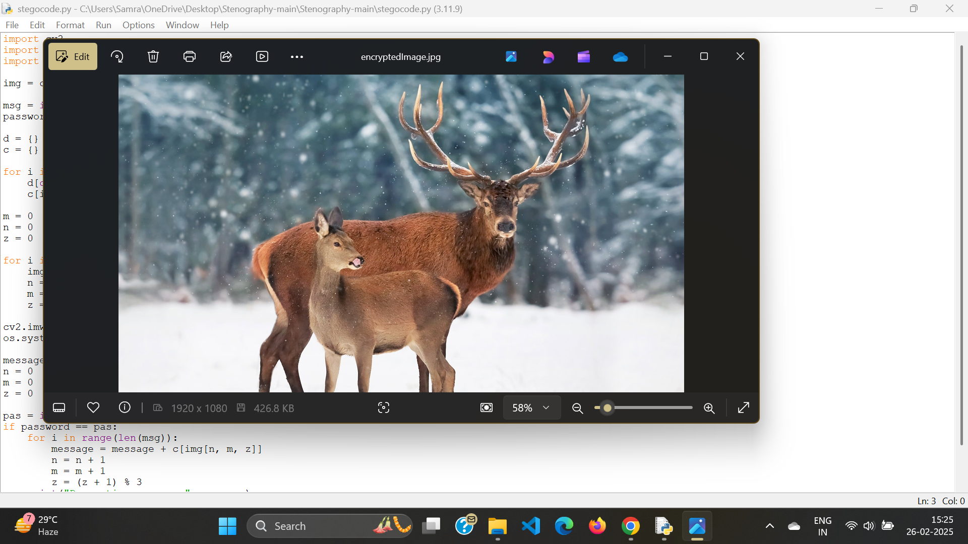
Image Generated

Slide 12
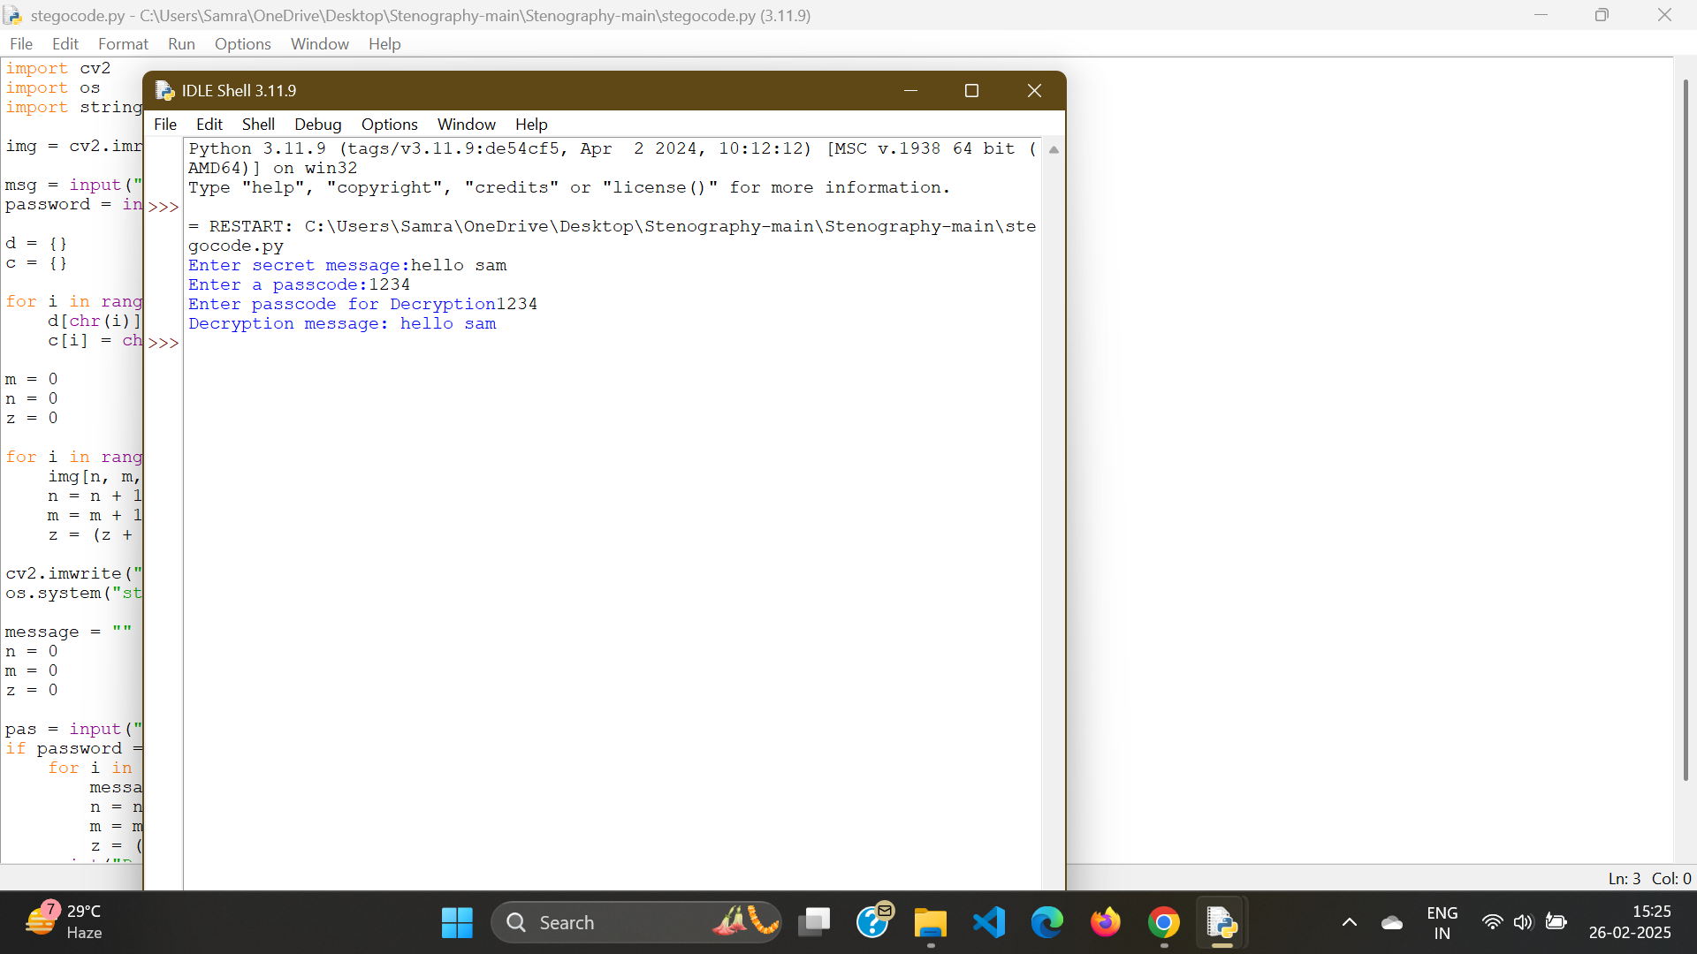
Output / encrypted message

Slide 13
Conclusion
In this project we used steganography to implement the encryption and decryptions of messages between the images.
We used AES (Advanced Encryption System) Technology to cipher the text between the images by changing the ASCII value between the images and also associating the unique key so as to secure transfer of data in the encrypted form .
We implemented the code through which we encrypt the data in the images for secure transfer later .

Slide 14
GitHub Link
Make sure that there should be readme file
https://github.com/samraddhi210/Steganography_Using_Python_Project.git

Slide 15
Future scope(optional)
Future of Cyber Security is bright with a growing demand of skilled professionals .
As the new technology is emerging as the threat of information leaks is also emerging so for that we need professionals to tackle the situations and here comes to role cyber security.
Scope of Cyber Security is not specific to any single field but every field needs cyber security not just to ensure information leaks but also to ensure that system is secure from external attacks and exploitations.
As there is rapid growth in the cyber security industry , new opportunities for people is also emerging in the field.

Slide 16
THANK YOU

